Slide 1




Our Vision Provide field training and training support that makes a lasting difference
Our Mission
Make great maintainers even better
& communicators
^
Notes:
FTD’s mission is not to create the new maintainers…that falls to the 82d & 782d Training Groups…FTD’s mission is to take already great maintainers and make them even better!

Slide 2
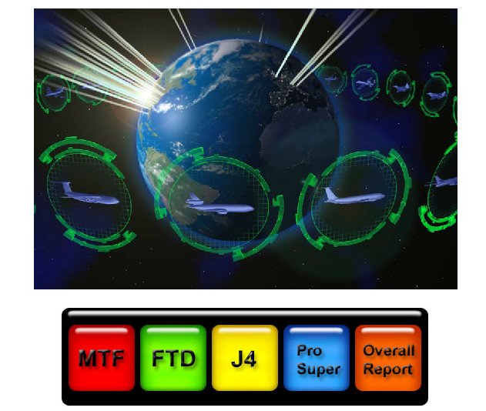
Sq Prod Report Interface
Squadron Production Report Maker
Field Training Scheduling System Interface
POCs:
Capt Madison Gilbert
SSgt Cody Pratt
Last Updated 2 July 2013
FOR OFFICIAL USE ONLY
Notes:
You have seen the schoolhouse here at Sheppard.
We are an extension of the schoolhouse for crew chief initial skills training, as 15 of our Dets teach enlisted AFSC-awarding initial skills training, complete with dorms and MTLs.
But that is only 8% of our production – the remaining 92% is advanced training for not only crew chiefs, but avionics, weapons, hydraulics and other aircraft mx AFSCs on 22 weapons systems. While we do not actually award 5-or7-skill levels, we do provide training that is required for their award. Our Dets typically see new mx personnel about a year after they finish tech school and continue to train them intermittently throughout their career.

Slide 3
Sq Production Report Interface
The Squadron Report Maker Interface enables information inputted into FTSS to be searched and organized into different reports.
Such reports include:
Course Demand Response Utilization (sorted by Det, AFSC, or MDS)
Instructor Hours Overall (sorted by Det, AFSC, or MDS)
Detachment Hour Totals
Instructor Hours Breakdown by Det
MDS Training Capacity

Slide 4

Sq Prod Report Interface
Overview
Access (Slide 5)
Filters (Slides 6-7)
Course Demand Response Utilization (Slides 8-9)
Instructor Hours Overall (Slides 10-11)
Detachment Hours Totals (Slides 12-13)
Instructor Hours Breakdown by Det (Slides 14-15)
MDS Training Capacity (Slides 16-17)
Info Management/Editors (Slides 18-21)
Summary/Contact Information (Slide 22)

Slide 5
Sq Prod Report Interface Access
For Access:
Click on the following Link:
https://app-eis.aetc.af.mil/amt/Document%20Library/Draft/SqProdReportMaker.accdb
Use CAC Email certificate (must select email certificate)
Click on Open SQProdReportMaker
Select Read Only
Select the Enable Content button
If you do not have access to the interface or to FTSS, you will need to send an email to 982TRG_CCK@sheppard.af.mil requesting access to FTSS. Include that you are in a leadership position and need access to the FTD and/or ProSuper tabs. If you are at the Squadron level, let them know that as well as the tabs you need access to.
If you are still having trouble, feel free to contact Capt Gilbert at DSN 682-8150 for additional help.

Slide 6
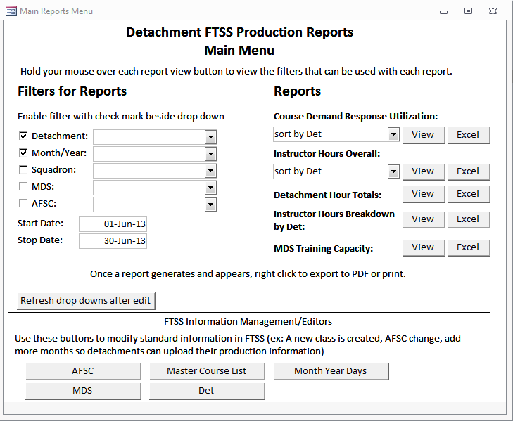
Filters
Filters for Reports
Filters are provided to the user for more advanced and more specified reports.
Using a filter will eliminate all results in the report except for the data requested (ie if the “Detachment” filter is checked, and “305 Charleston” is selected, the reports will only show data from Detachment 305.)
To use a filter, check the box to the left of the filter.
To determine which filters are used for a specific report, hover over the report “View” button (ie if you want to view the “Instructor Hours Breakdown by Det” Report, hovering your mouse over the “View” button reveals the following:
Thus, any and/or all filters can be used except start/stop date for this report.
NOTE: An error will occur if a filter box is checked but no filter is selected. Either unselect the boxes or select filters!

Slide 7
Filters
Filters for Reports
The “Start Date” and “Stop Date” are ONLY required and used for the “Course Demand Response Utilization” Report. All other reports do not use this filter.
Once the user has selected or changes the applicable filters, he or she must click the “Refresh drop downs after edit” button before selecting a report

Slide 8
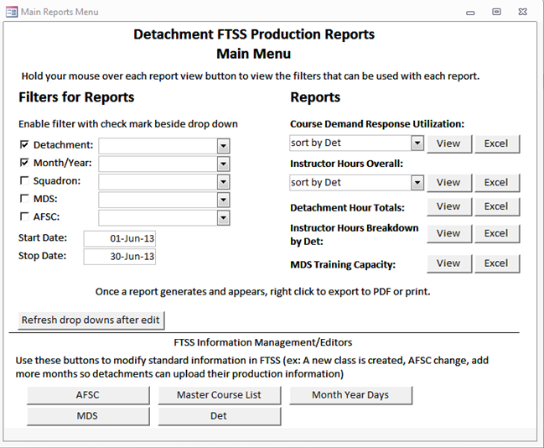
Course Demand Response Ute
Reports: Course Demand Response Utilization
The Course Demand Response Utilization Report:
Shows the Demand Response Rate
Can be sorted by Det, AFSC, or MDS.
Sorting does not eliminate any data like filtering, but separates the data into these categories
Can be filtered by Det, Squadron, MDS, and AFSC.
Filtering eliminates certain data in a report so that a specific det/squadron/MDS/AFSC can be viewed
NOTE:
“Start Date” and “Stop Date” MUST BE USED.
Also, an error will occur if a filter box is checked but no filter is selected. Either unselect the boxes or select filters.

Slide 9
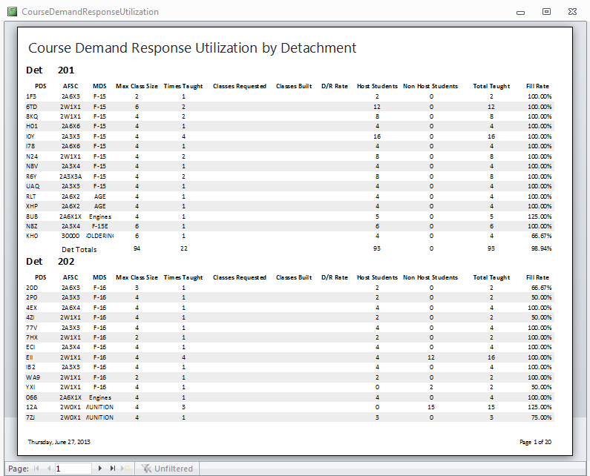
Course Demand Response Ute
Reports: Course Demand Response Utilization
This report was sorted by Detachment
This report shows the PDS code, AFSC, MDS, Max Class Size, Times the course was taught, classes requested, classes built, Demand Response Rate, # of Host Students, # of Non Host Students, Total Students Taught, and the Fill Rate.
To see the rest of the report, change page right or left

Slide 10
Instructor Hours Overall
Reports: Instructor Hours Overall
The Instructor Hours Overall Report:
Shows hours instructed by each instructor, as well as non-teaching hours and percentage of time taught
Can be sorted by Det, AFSC, or MDS.
Sorting does not eliminate any data like filtering, but separates the data into these categories
Can be filtered by Det, Month/Year, Squadron, MDS, and AFSC.
Filtering eliminates certain data in a report so that a specific Det/squadron/MDS/AFSC can be viewed
NOTE: An error will occur if a filter box is checked but no filter is selected. Either unselect the boxes or select filters.

Slide 11
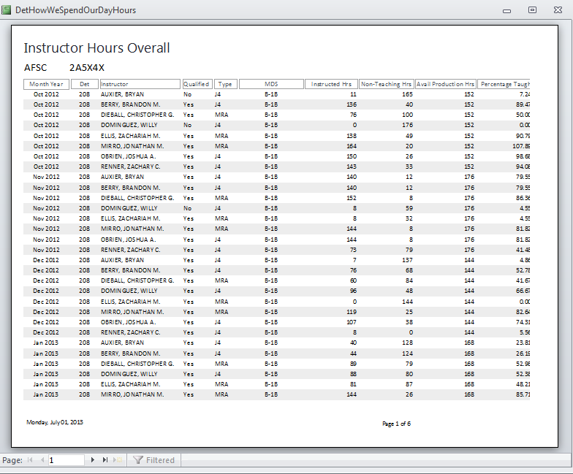
Instructor Hours Overall
Reports: Instructor Hours Overall
This report example was sorted by AFSC
This report shows the Month/Year, Det, Instructor, Qualification (Y/N), Type (J4/MRA), MDS, Instructed Hours, Non-teaching Hours, Available Production Hours, and Percentage Taught.
To see the rest of the report, change page right or left. Totals can be seen at the end.

Slide 12
Detachment Hour Totals
Reports: Detachment Hour Totals
The Detachment Hours Totals Report:
Shows data for each det during a specific Month/Year, to include Total Available Hours, Total Instructed Hours, Total Non-teaching Hours, Total Hours Logged, and the Percentage Taught.
Can be filtered by Month/Year, and Det or Squadron.
Filtering eliminates certain data in a report so that a specific Det/Month/Year, and/or squadron can be viewed
NOTE: An error will occur if a filter box is checked but no filter is selected. Either unselect the boxes or select filters.

Slide 13
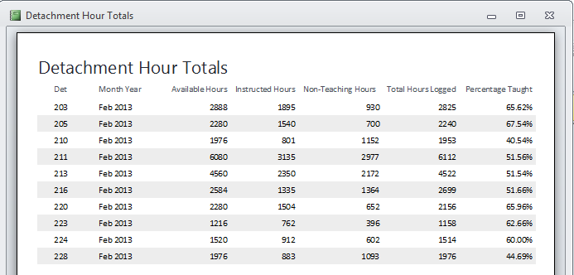
Detachment Hour Totals
Reports: Detachment Hour Totals
Instruction Hours (classroom, flight line, and training sessions)
Hours spent in additional duties & CCD
Number of Duty Days in One Month x 8 Hours x Number of Instructors
Instructed Hours / Available Hours
Instructed Hours + Non-Teaching Hours

Slide 14
Instructor Hours Breakdown by Det
Reports: Instructor Hours Breakdown by Det
The Instructor Hours Breakdown by Det:
Breaks down instructor hours into specific areas (formal course, fill-in, MTTs, Training Sessions, Additional Duties, etc), sorted by instructor.
Can be filtered by Det, Month/Year, Squadron, MDS, and AFSC.
Filtering eliminates certain data in a report so that a specific Det/squadron/MDS/AFSC can be viewed
NOTE: An error will occur if a filter box is checked but no filter is selected. Either unselect the boxes or select filters.

Slide 15
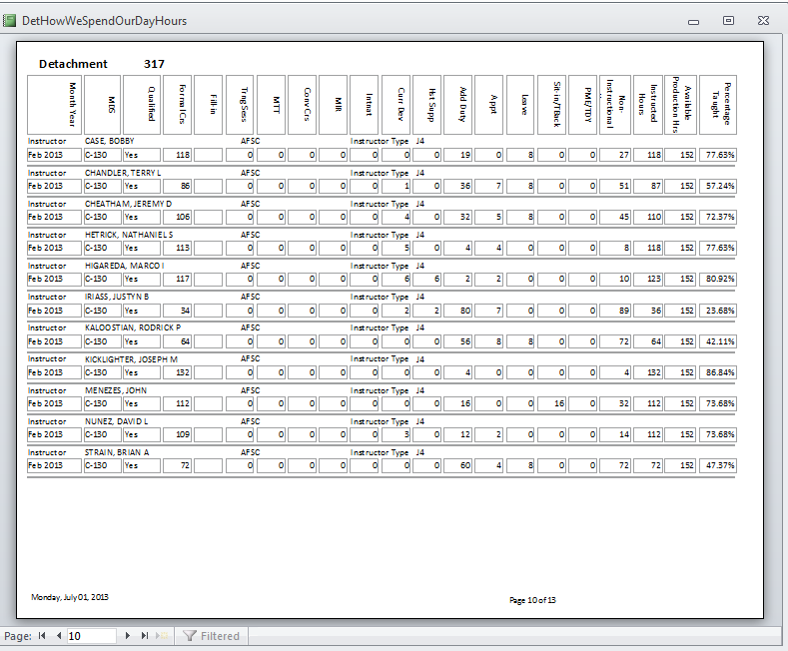
Instructor Hours Breakdown by Det
Reports: Instructor Hours Breakdown by Det
This Report categorizes the instructors’ hours into the following:
Formal Course Hours
Fill-in Hours
Training Sessions
MTTs
Conversion Courses
MIRs
International
Curriculum Development
Host Support
Additional Duty
Appointment
Leave
Sit-in or Teach-back
PME or TDY
Non-Instructional
Non-Instructional Total: counts all columns minus formal crs and curr dev
Instructional Hours: counts formal crs and curr dev
Number of Duty Days in One Month x 8 Hours
Instructed Hours / Available Production Hrs

Slide 16
MDS Training Capacity
Reports: MDS Training Capacity
The MDS Training Capacity Report:
Depicts the Training Capacity at a certain base sorted by MDS.
Can be filtered by Det, Month/Year, Squadron, and MDS.
Filtering eliminates certain data in a report so that a specific Det/Month/Year/Squadron/MDS can be viewed
NOTE: An error will occur if a filter box is checked but no filter is selected. Either unselect the boxes or select filters.

Slide 17
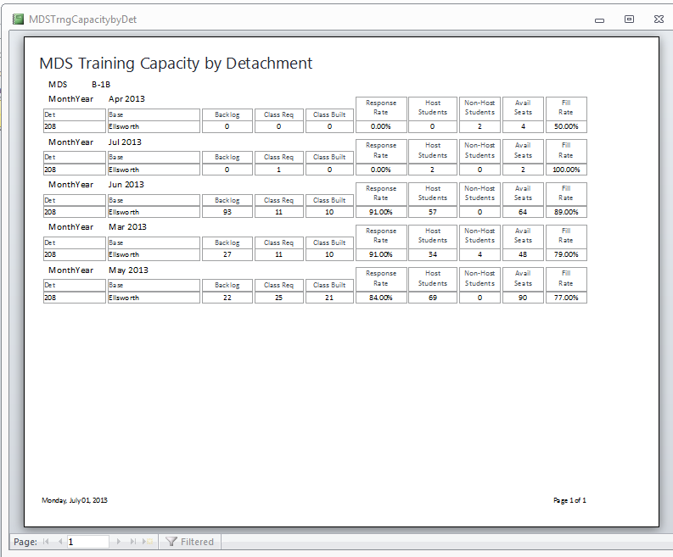
MDS Training Capacity
Reports: MDS Training Capacity
This Report shows the following information for a certain MDS, sorted by Month/Year, and further soreted by Detachment:
Backlog
Classes Requested
Classes Built
Response Rate
Host Students
Non-Host Students
Available Seats
Fill Rate
Classes Built / Classes Requested
(Host Students + Non Host Students) / Available Seats

Slide 18
Info Management/Editors
FTSS Information Management/Editors
The buttons listed under the FTSS Information Management/Editors can be used to modify standard information in FTSS.
NOTE: Changing AFSCs, MDSs, etc automatically saves the information to FTSS. Do not use these editors unless you are absolutely sure you want the changes to be permanent!

Slide 19
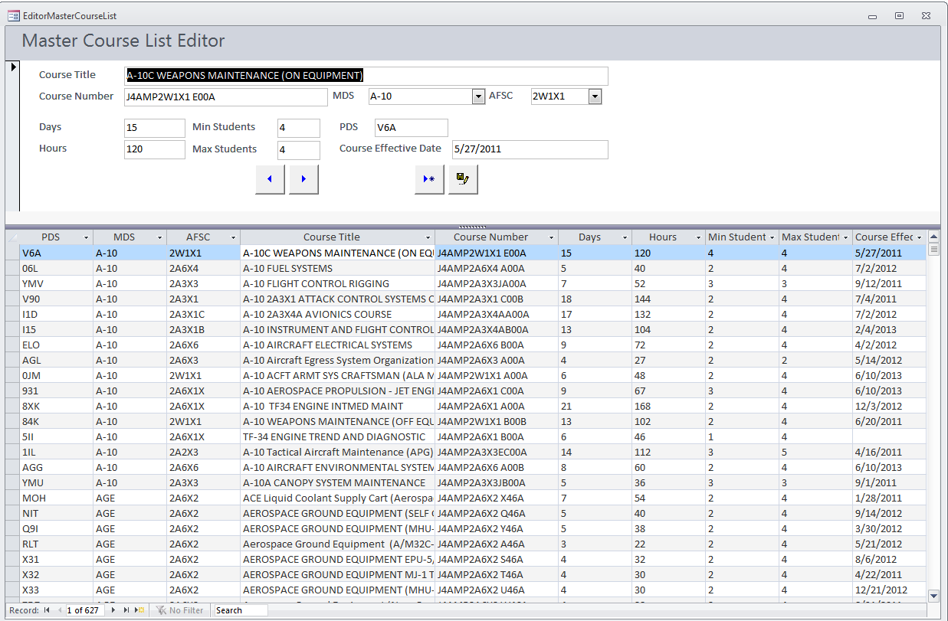
Info Management/Editors
Info Management/Editors: Master Course List
To change information for a course, alter the information in the boxes at the top
To add a course to the Master Course List, press this button and fill out the information at the top
To save the information, click this button

Slide 20
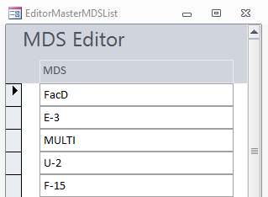
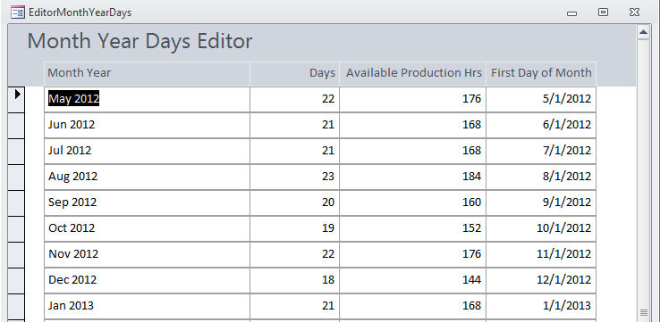
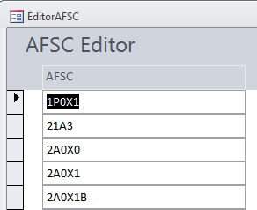
Info Management/Editors
Info Management/Editors: MDS/AFSC/Month-Year-Days
To change or add a MDS, AFSC, or Month/Year/Days, alter the information in the box or add information to a blank box at the bottom; when you exit, it will automatically save any changes made

Slide 21
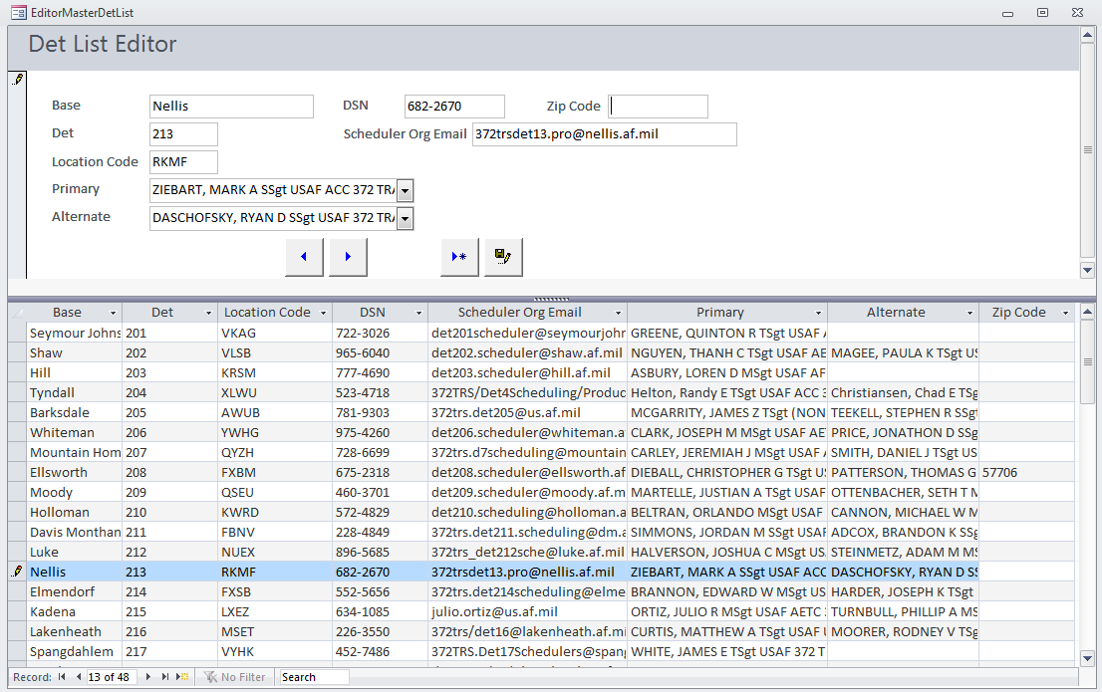
Info Management/Editors
Info Management/Editors: Det
To change information from your base, click the base, then alter the information at the top. Upon completion, click the save button.

Slide 22
Summary
Summary
Access (Slide 5)
Filter Information (Slides 6-7)
Report Information (Slides 8-17)
Information Management/Editors Procedures (Slides 18-21)
Summary/Contact Information (Slide 22)
Questions? Suggestions on ways to make this instructional guide or MTF FTSS Interface better for those using it in the future?
Please do not hesitate to email/call: Capt Gilbert (madison.gilbert.1@us.af.mil) at DSN 682-8150 or SSgt Pratt (cody.pratt@ellsworth.af.mil) at DSN 675-2318.

